Slide 1
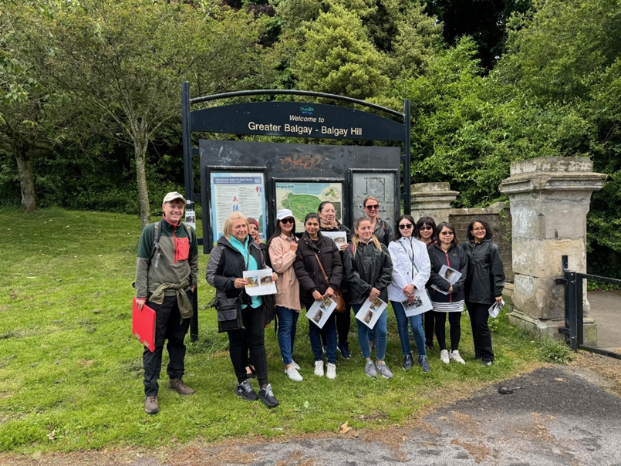


Recording Balgay Park: digital skills and archaeology
Kieran Manchip, Project Officer, Archaeology Scotland – k.manchip@archaeologyscotland.org.uk
Amina Moti, Finding You With Amy,

Slide 2
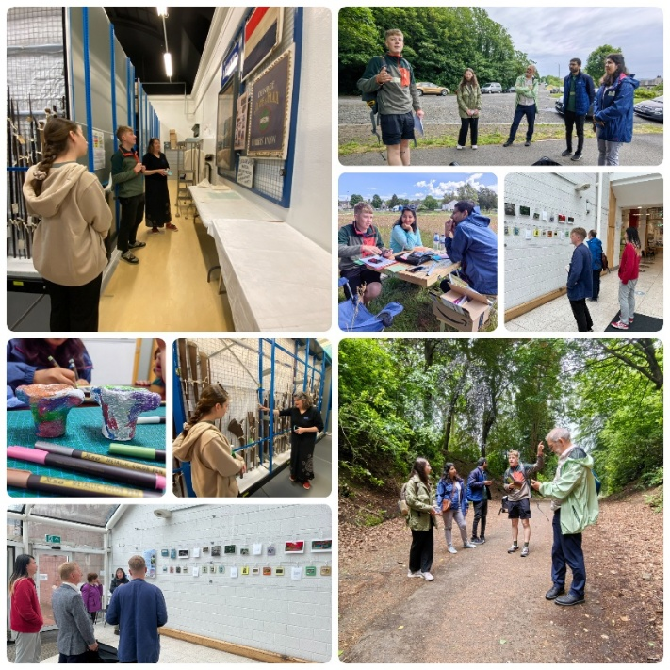
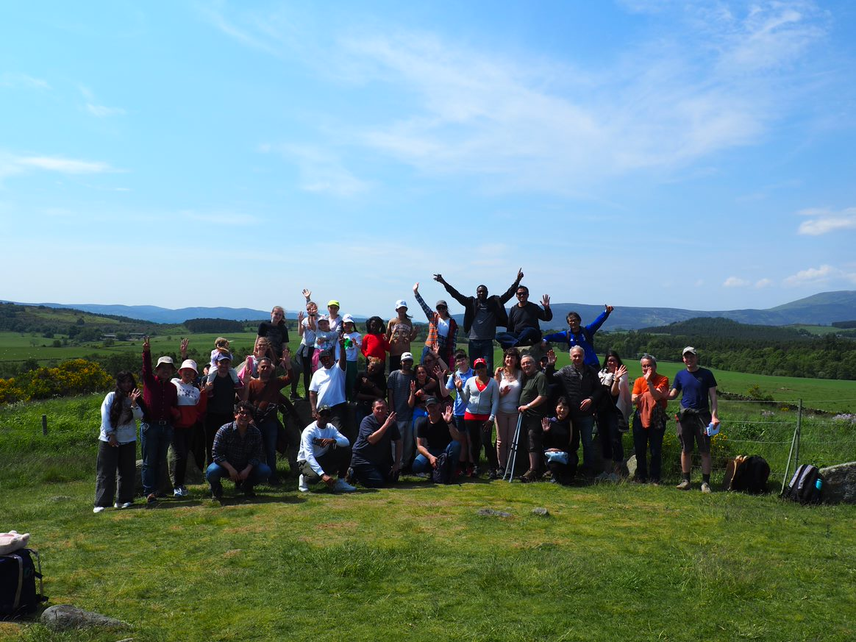
New Audiences
Widen Participation in Scottish Archaeology
Marginalized and Displaced Communities
Cultural Heritage/Shared Cultural Heritage
Social Connections
Transferable Skills
Value of Archaeology for People, Places and Communities

Slide 3
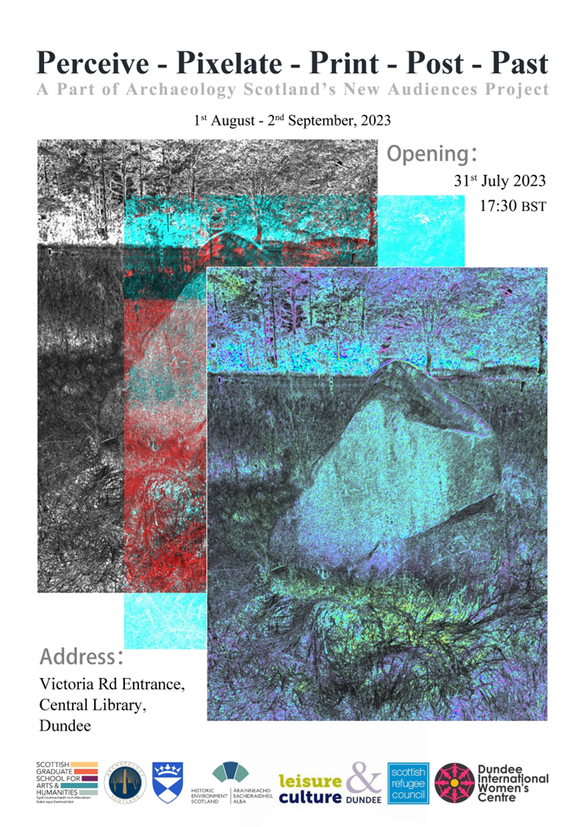
The Background: archaeology and New Scots in Dundee
Art and Archaeology: digital photography – Summer 2023
Introduction to Archaeology and History of Dundee – DIWC – Autumn/Winter 2023
Recording Balgay Park – Summer 2024
ESOL Toolkit Development – Autumn 2024
Welcoming and Wellbeing in Archaeology – Summer-Autumn 2025
Recording Balgay Park – Part 2 – Spring 2026

Slide 4
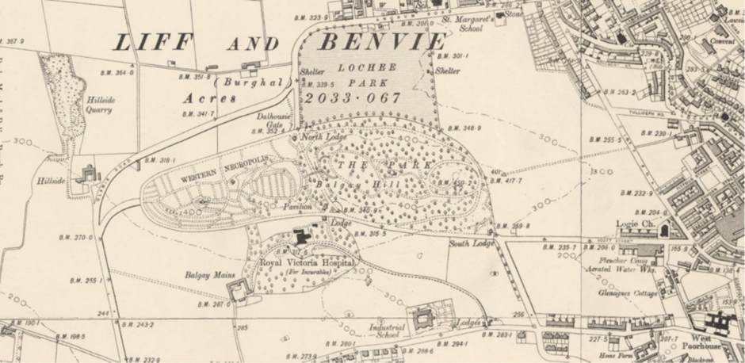
Recording Balgay Park
Funded by DigiTay
12 Week Project
12 women from BME backgrounds
Archaeological Survey Project as vehicle for learning (Digital English, Archaeological)
Wellbeing
Social Connections
CyberQuarter (thank you!) and Balgay Park
PowerBI delivered by DataUnderstood (thank you!)
Cyber Security by Abertay University (thank you!)

Slide 5
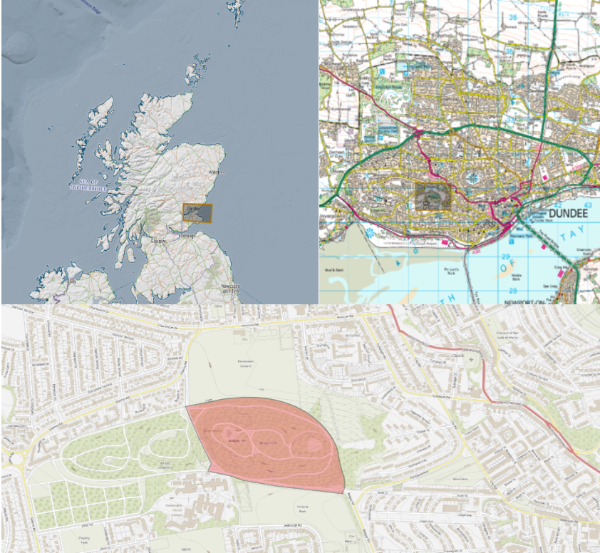
Survey Area

Slide 6
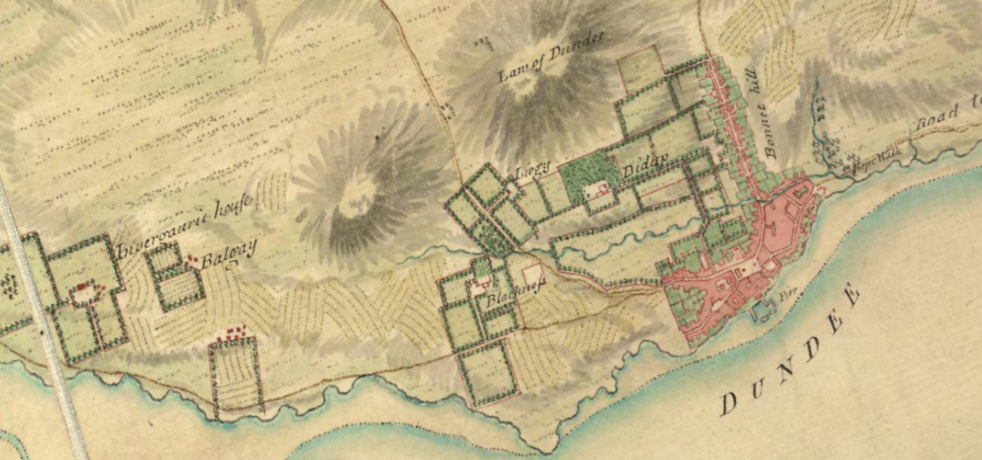
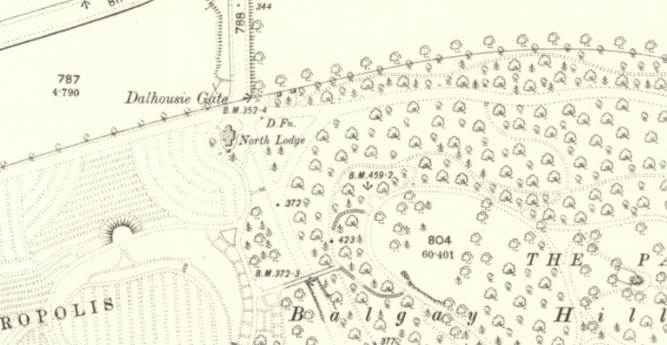
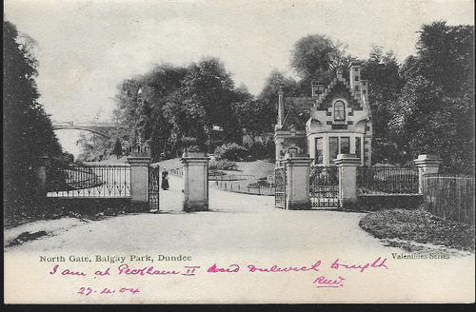
Phases of a Survey Project
Desk Based Assessment
Field Survey
Data Management
Data Analysis
Data Presentation

Slide 7
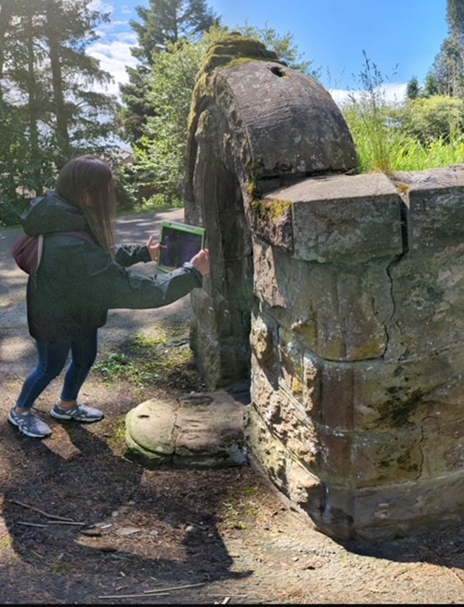
Digital Skills
Digital Skills in Setting of an archaeological survey project
Digital Recording in Archaeology
Intermediate
Advanced Digital Skills

Slide 8
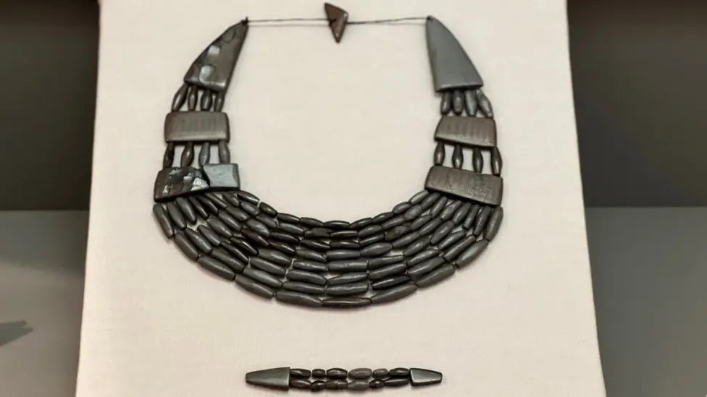
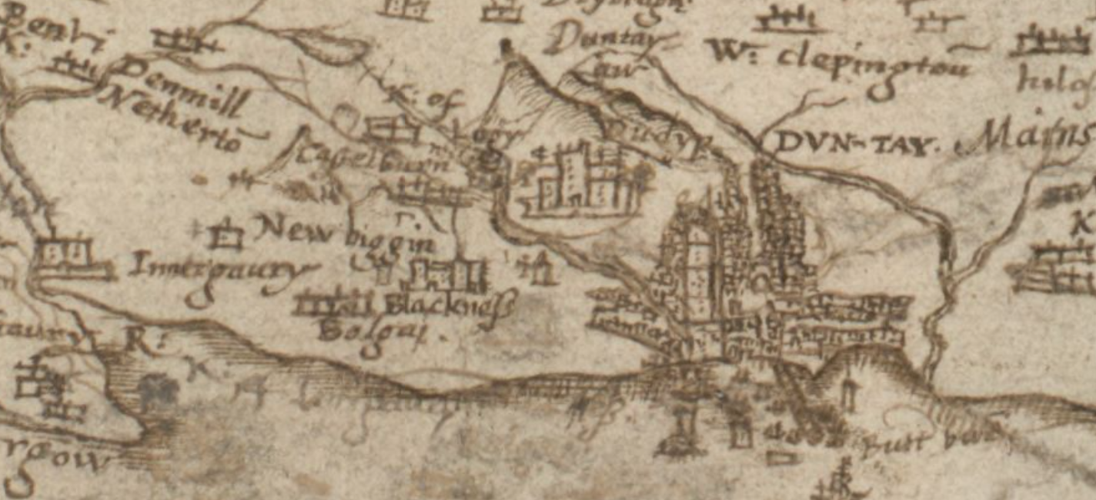
The Archaeology
Balgay Park, 1871
Site of Balgay Estate
Prehistory through to Contemporary Archaeology
Valuable Historic Greenspace
Variety of Stakeholders

Slide 9
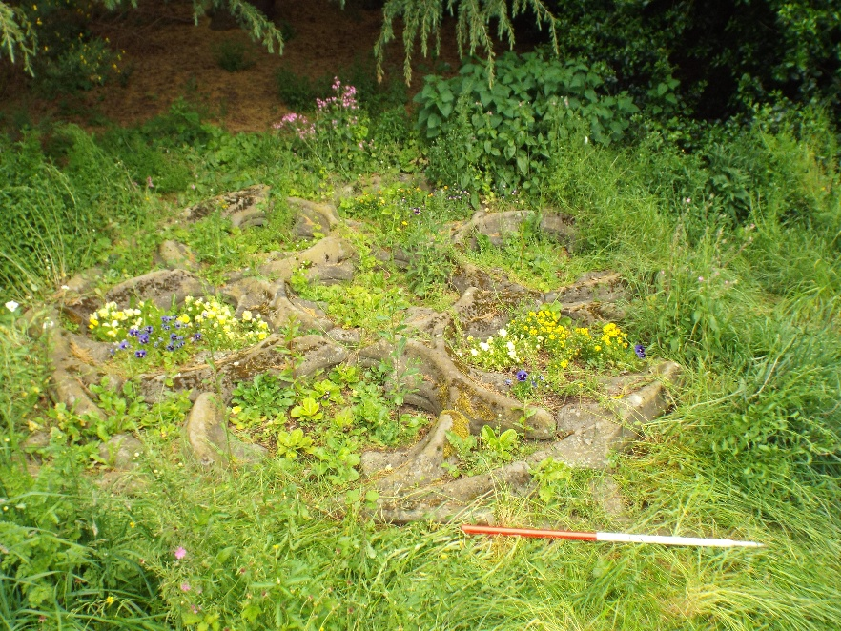
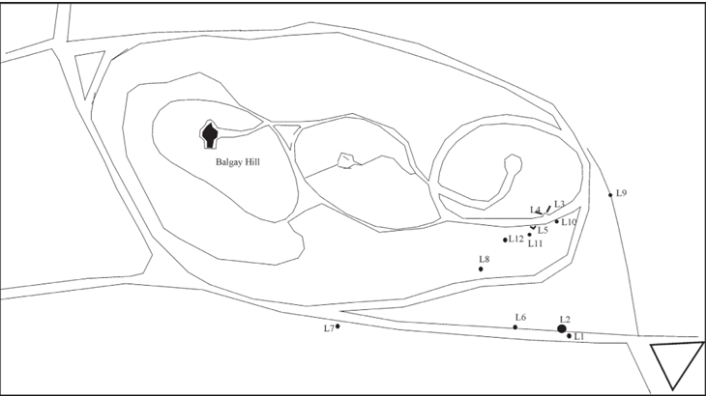
Rose Window and Carved Stone
Previous Work with Friends of Balgay Park
Previous Survey, SUAT 2002
Condition survey in 2011
(Cox and Perry, 2005)

Slide 10
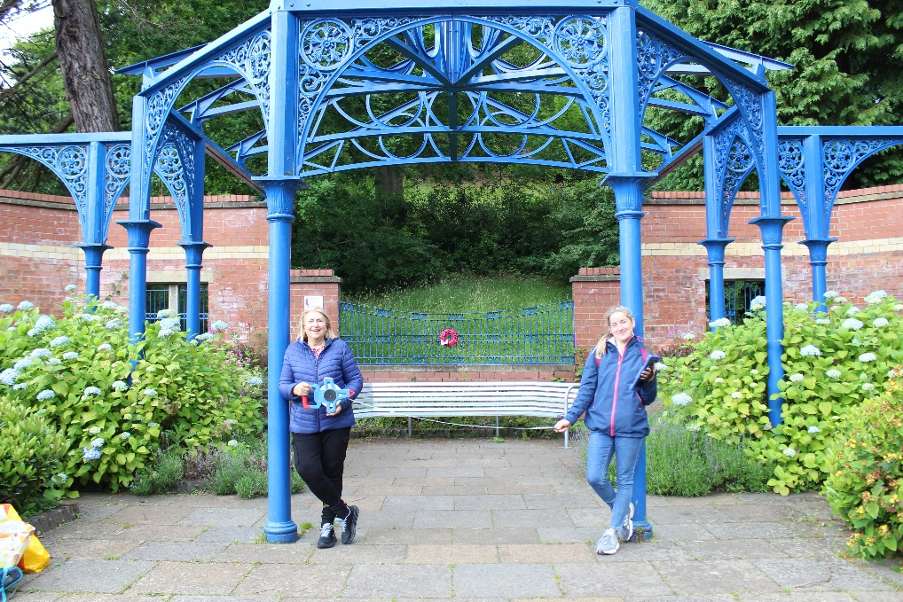
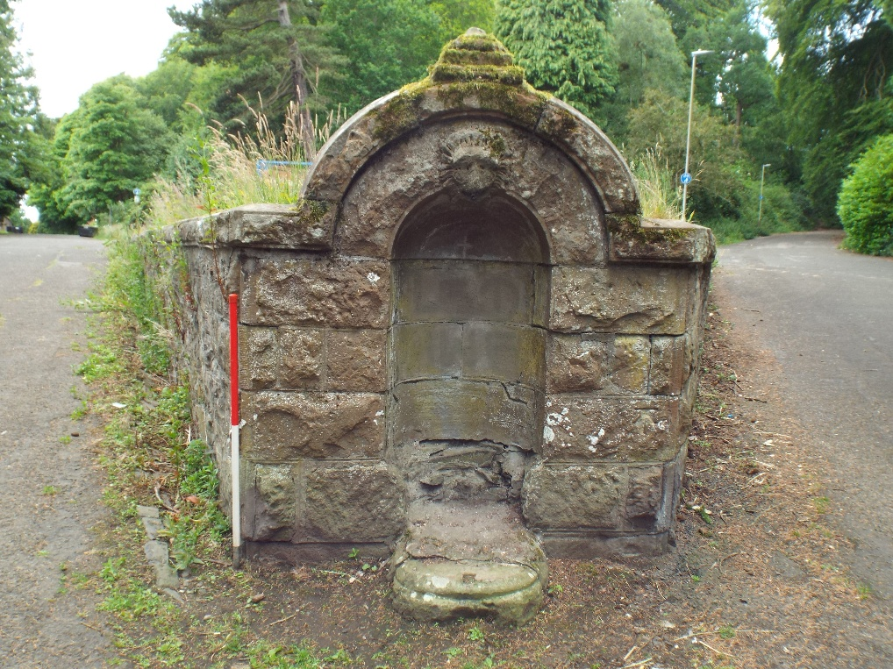
Victorian Archaeology
The Lodges
Avenues
Pavillion
Footbridge
Story of greenspaces and leisure in Victorian/Industrial Scotland
Note: adjacent “garden cemetery” – Western Necropolis

Slide 11
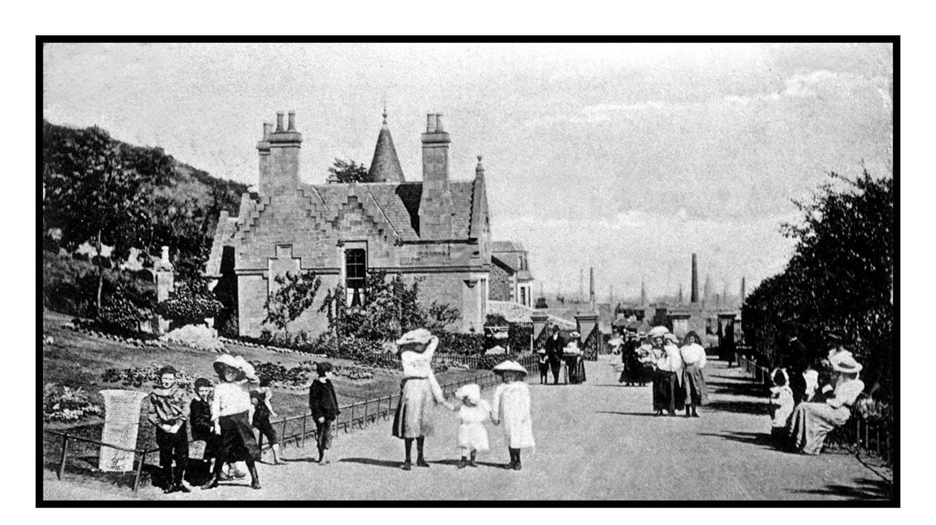
Gateways and Routeways

Slide 12
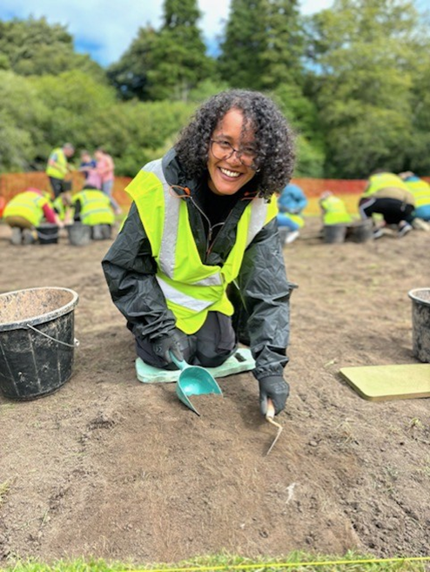
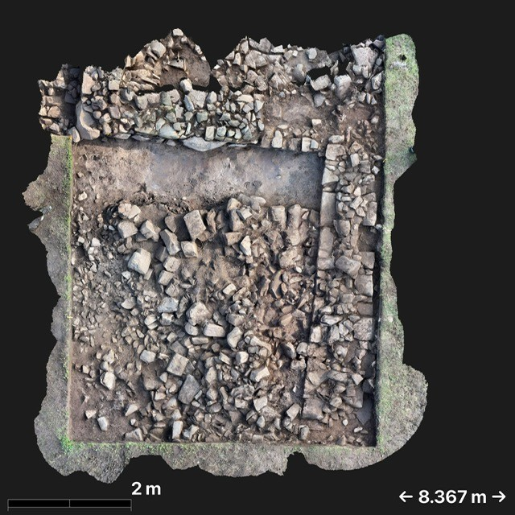
Bonus Trips!
Newbattle Abbey, Midlothian
Bedrule Castle, Scottish Borders
Excavation
Travel
Overnight Stay
More contribution to Scottish Archaeology!

Slide 13
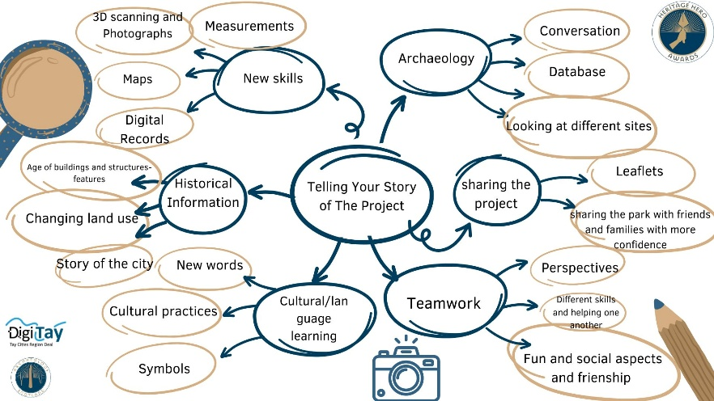
Evaluation
100% of participants said they would like to do more survey.
100% of participants agreed that survey sessions helped their English.
66.7% of participants rated the digital; field survey experience as very good.
“Working in the groups. Having conversation with people from different countries. Visiting Balgay Park and understanding the history of the places in there. And the most Enjoyable one was going to Edinburgh.”

Slide 14
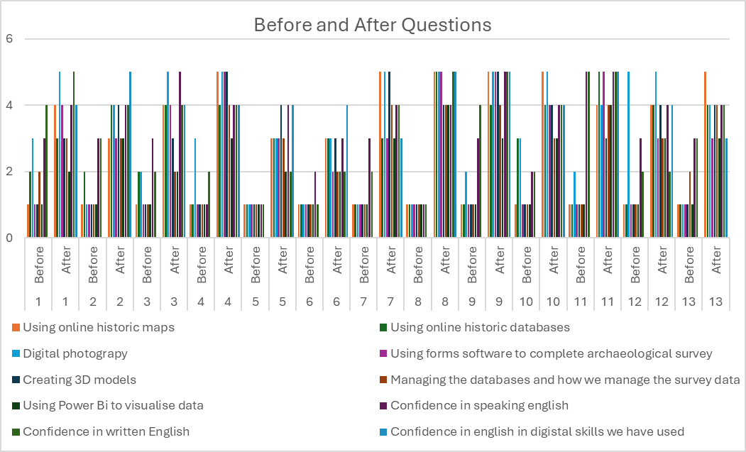

Slide 15
Qualitative
What did you learn?
“I learned a lot about history of Balgay Park. I discovered a lot of new interesting facts about park. Learn- collect informations details , measuring, scanning. A lot of new words.”
I learnt about the history of Balgay Park and how this change with passage of time”
“digital scanner, catalouge, online maps, a lot of history about Balgay park, new interesting facts about park, many new words"
What did you enjoy the most?
“I enjoyed that was in the park and we could see in real place what we learn about. I learn a lot about Balgay park history what makes me more interesting about parks and history of Dundee. I enjoy learn how get informatons like measuring and scanning.”
“Firstly I love being outdoors and secondly knowing how the park come about changes my whole experience of going to the parks. I'll always look with a searching eye.”
“Work in the groups visit historical and beautiful places in Balgay”

Slide 16
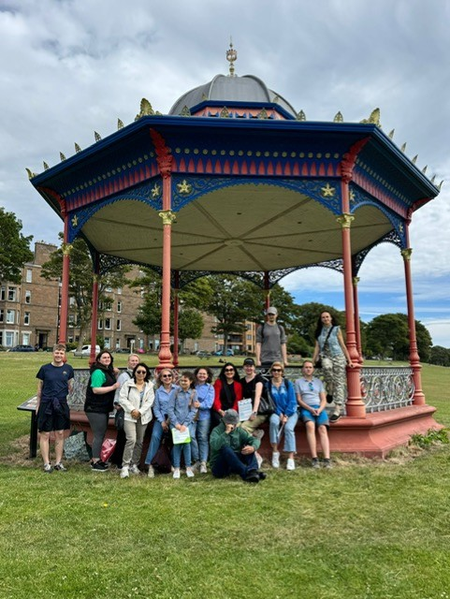
The Future
Recording Balgay Park, phase 2
New cohort
Archaeology of Dundee’s Parks
Share the stories and access of these important historical places and landscapes
A community dig?!

Slide 17

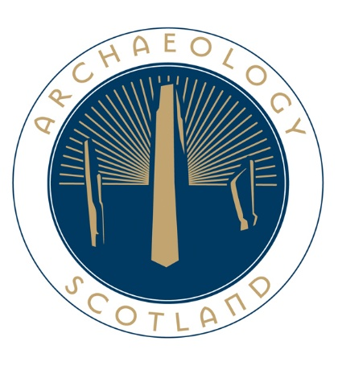
Thanks for the invitation and for your time!
Archaeology and it’s unique blend of people and place
Practical archaeological skills project as a vehicle
Value of Past in Contemporary and Future

